Slide 1
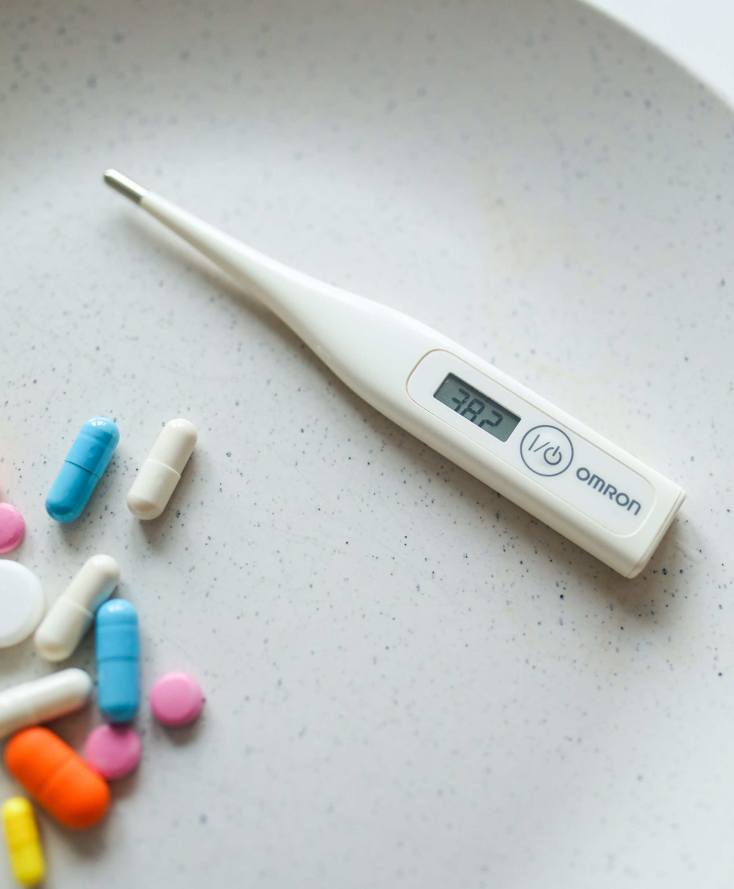
Online Pharmacy System
Y3.S1.WE.IT.03
REG/WE/69

Slide 2
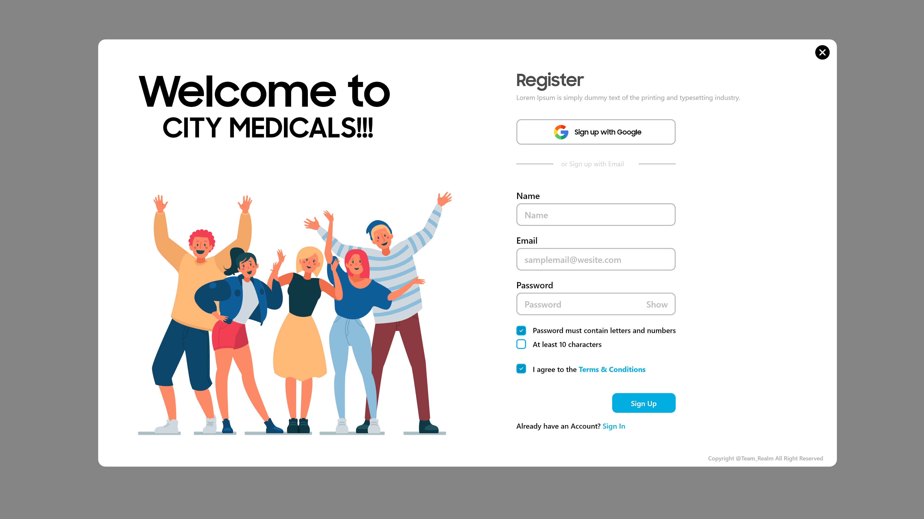
User-Register

Slide 3
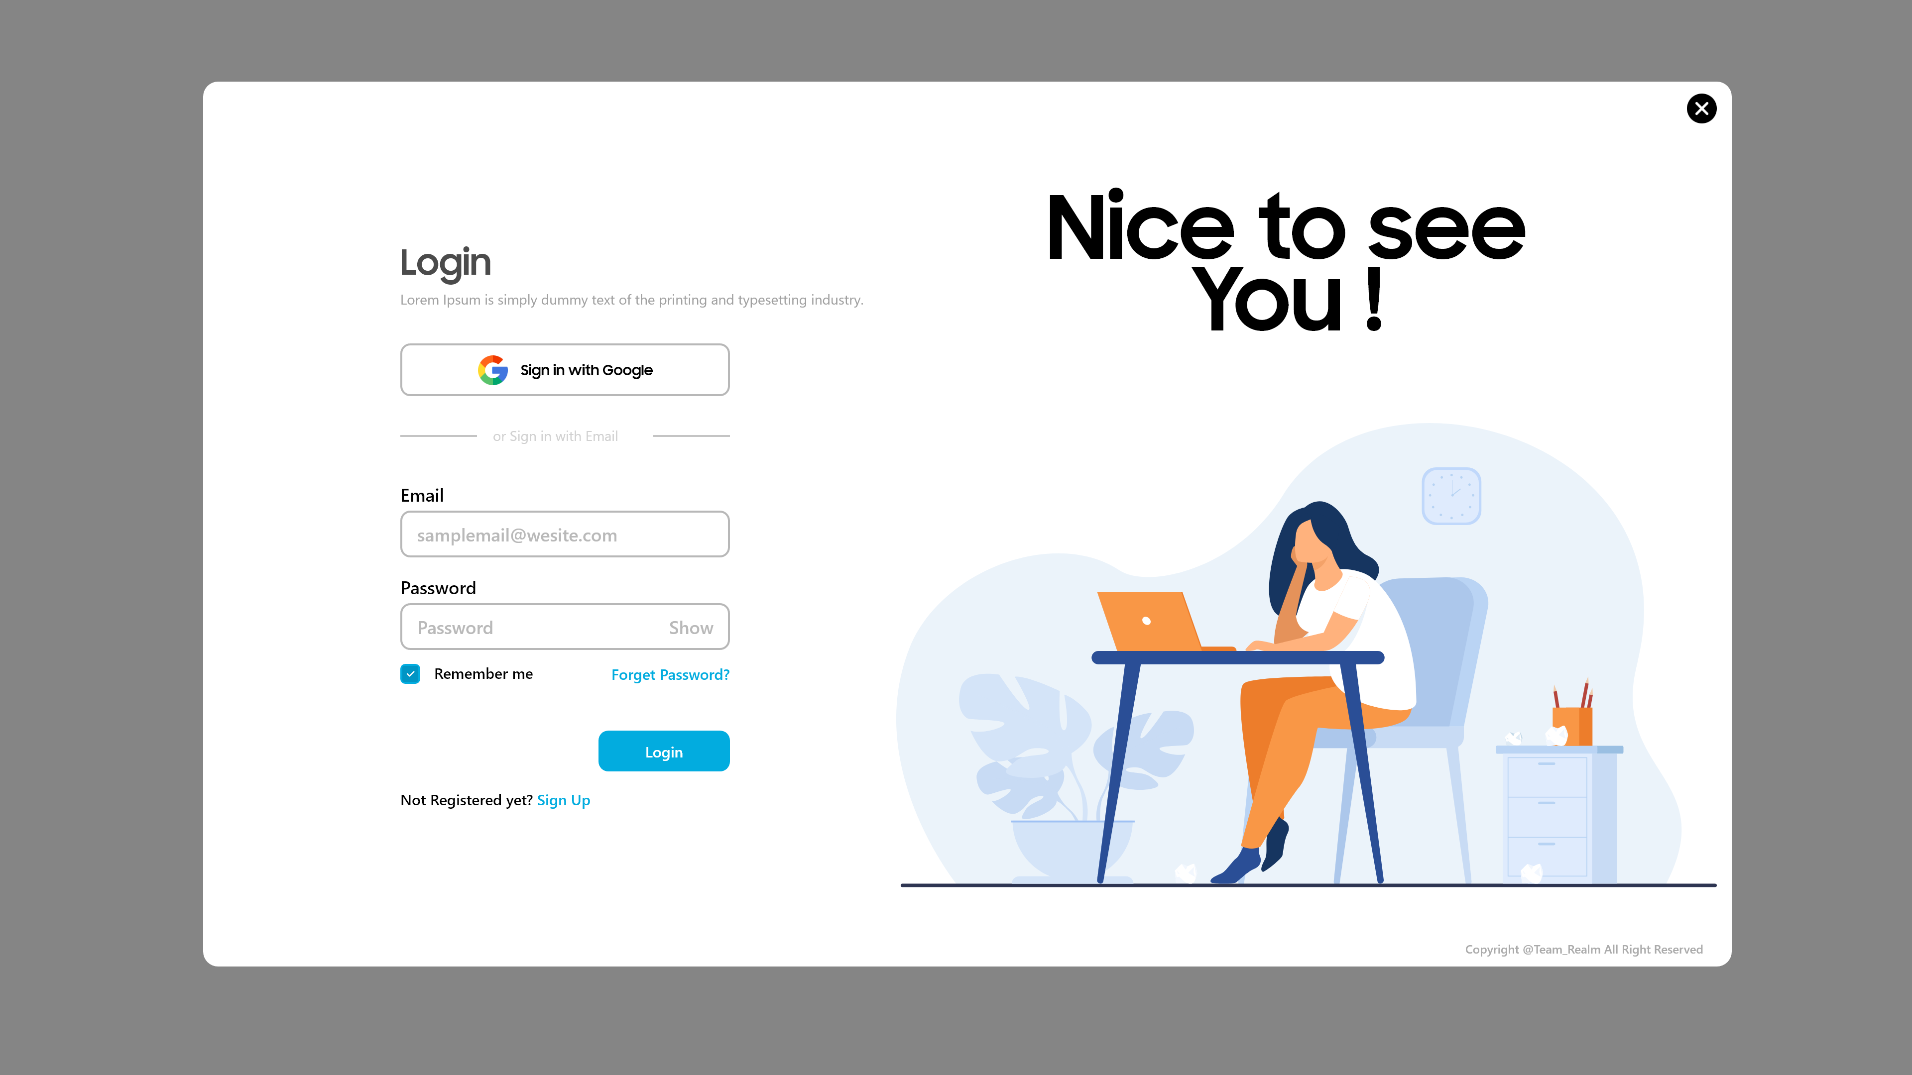
User-Login

Slide 4
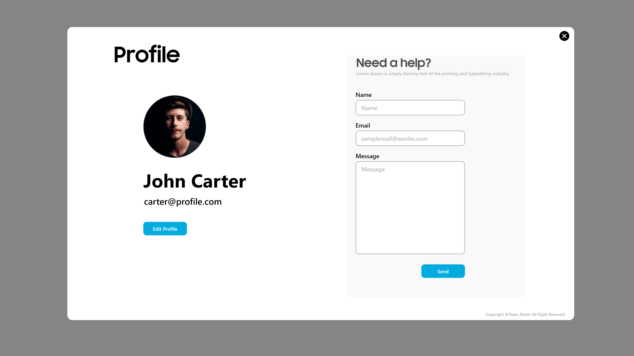
User-Update Profile

Slide 5
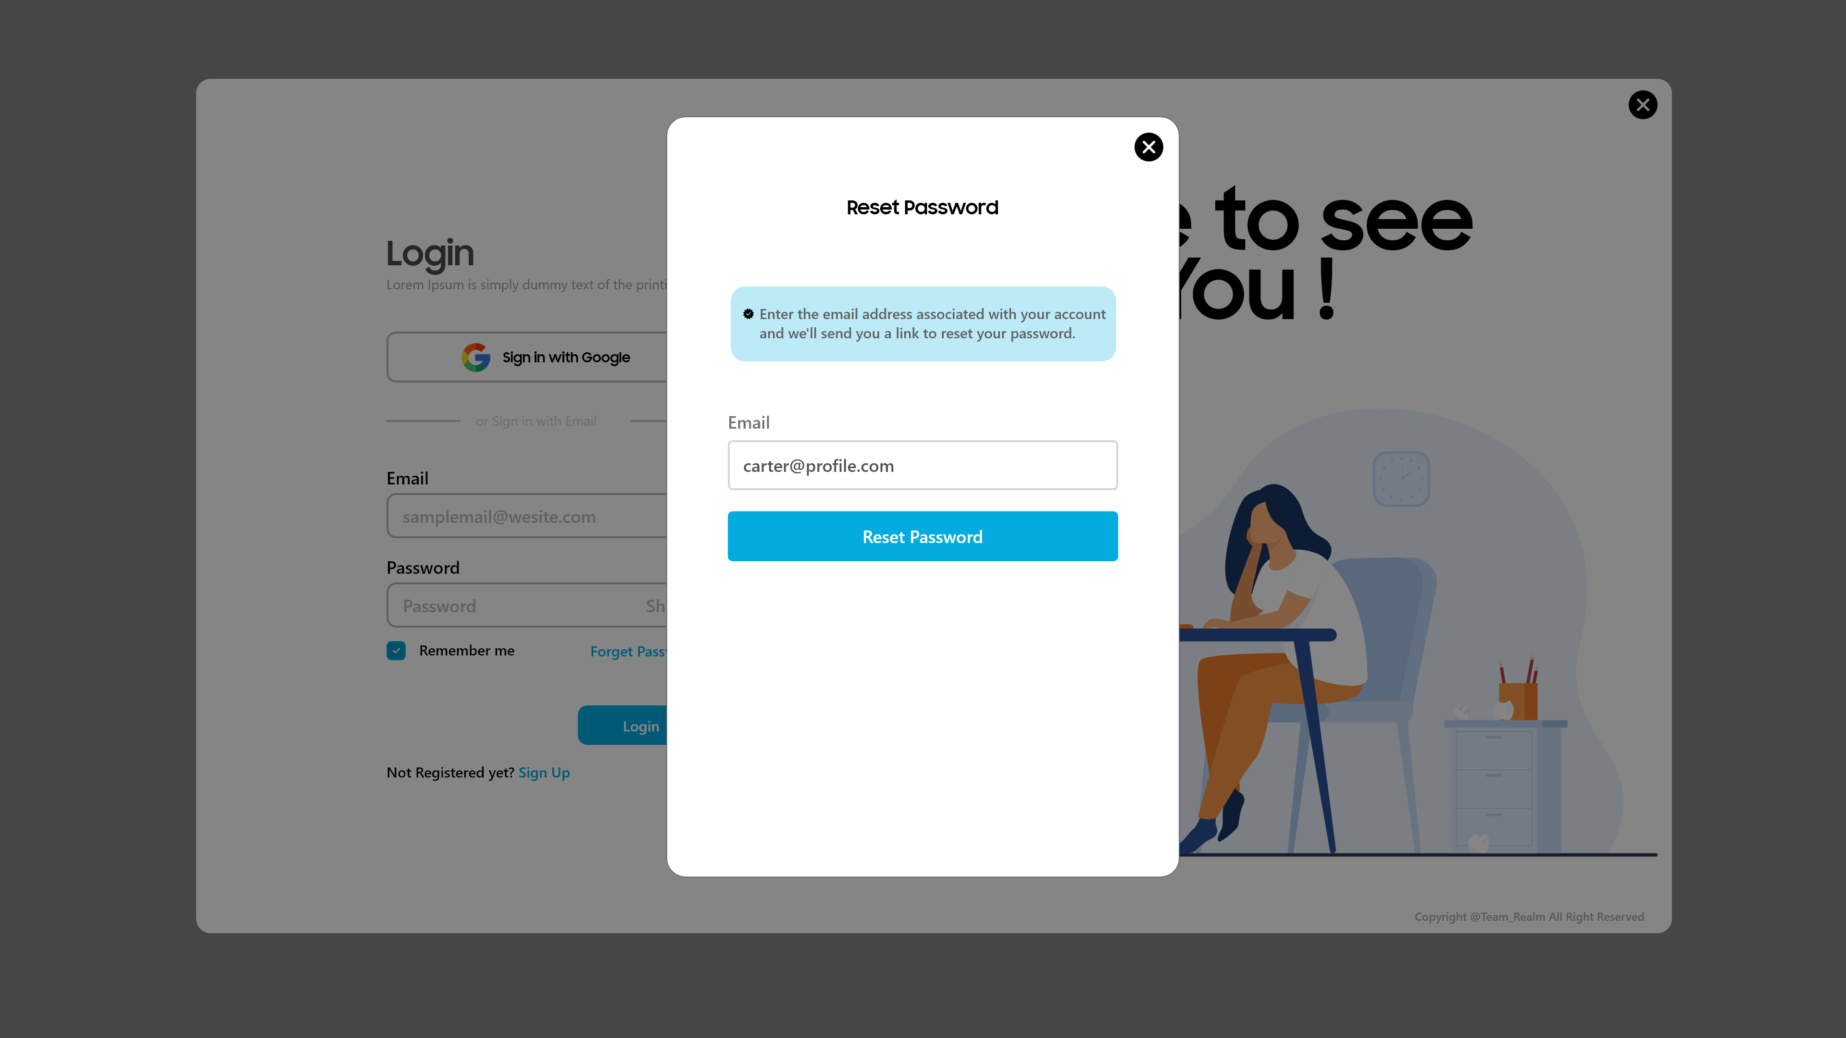
User-Reset Password

Slide 6
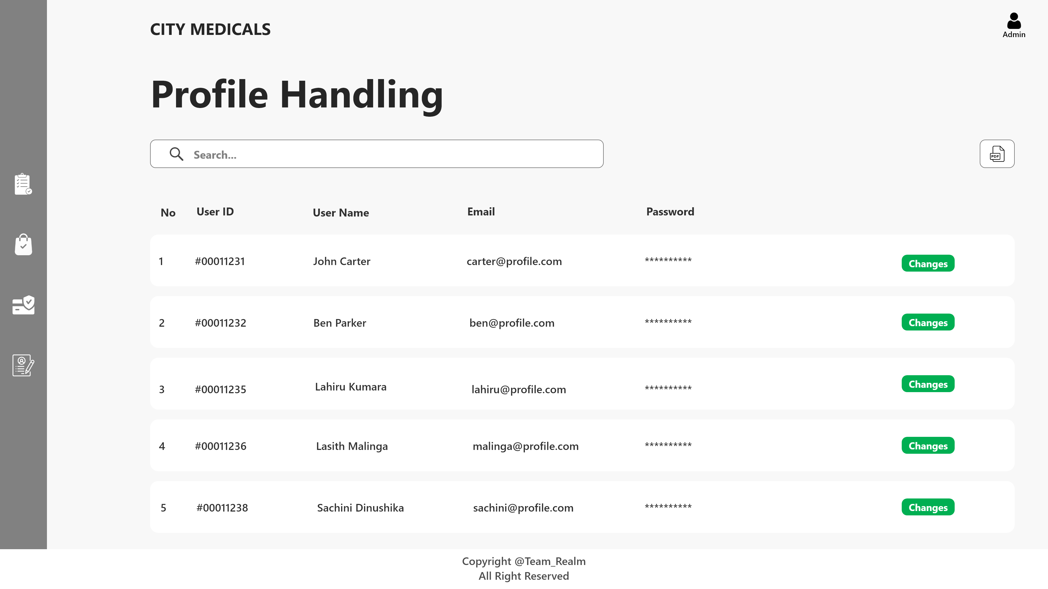
Admin-User Profile Handling

Slide 7
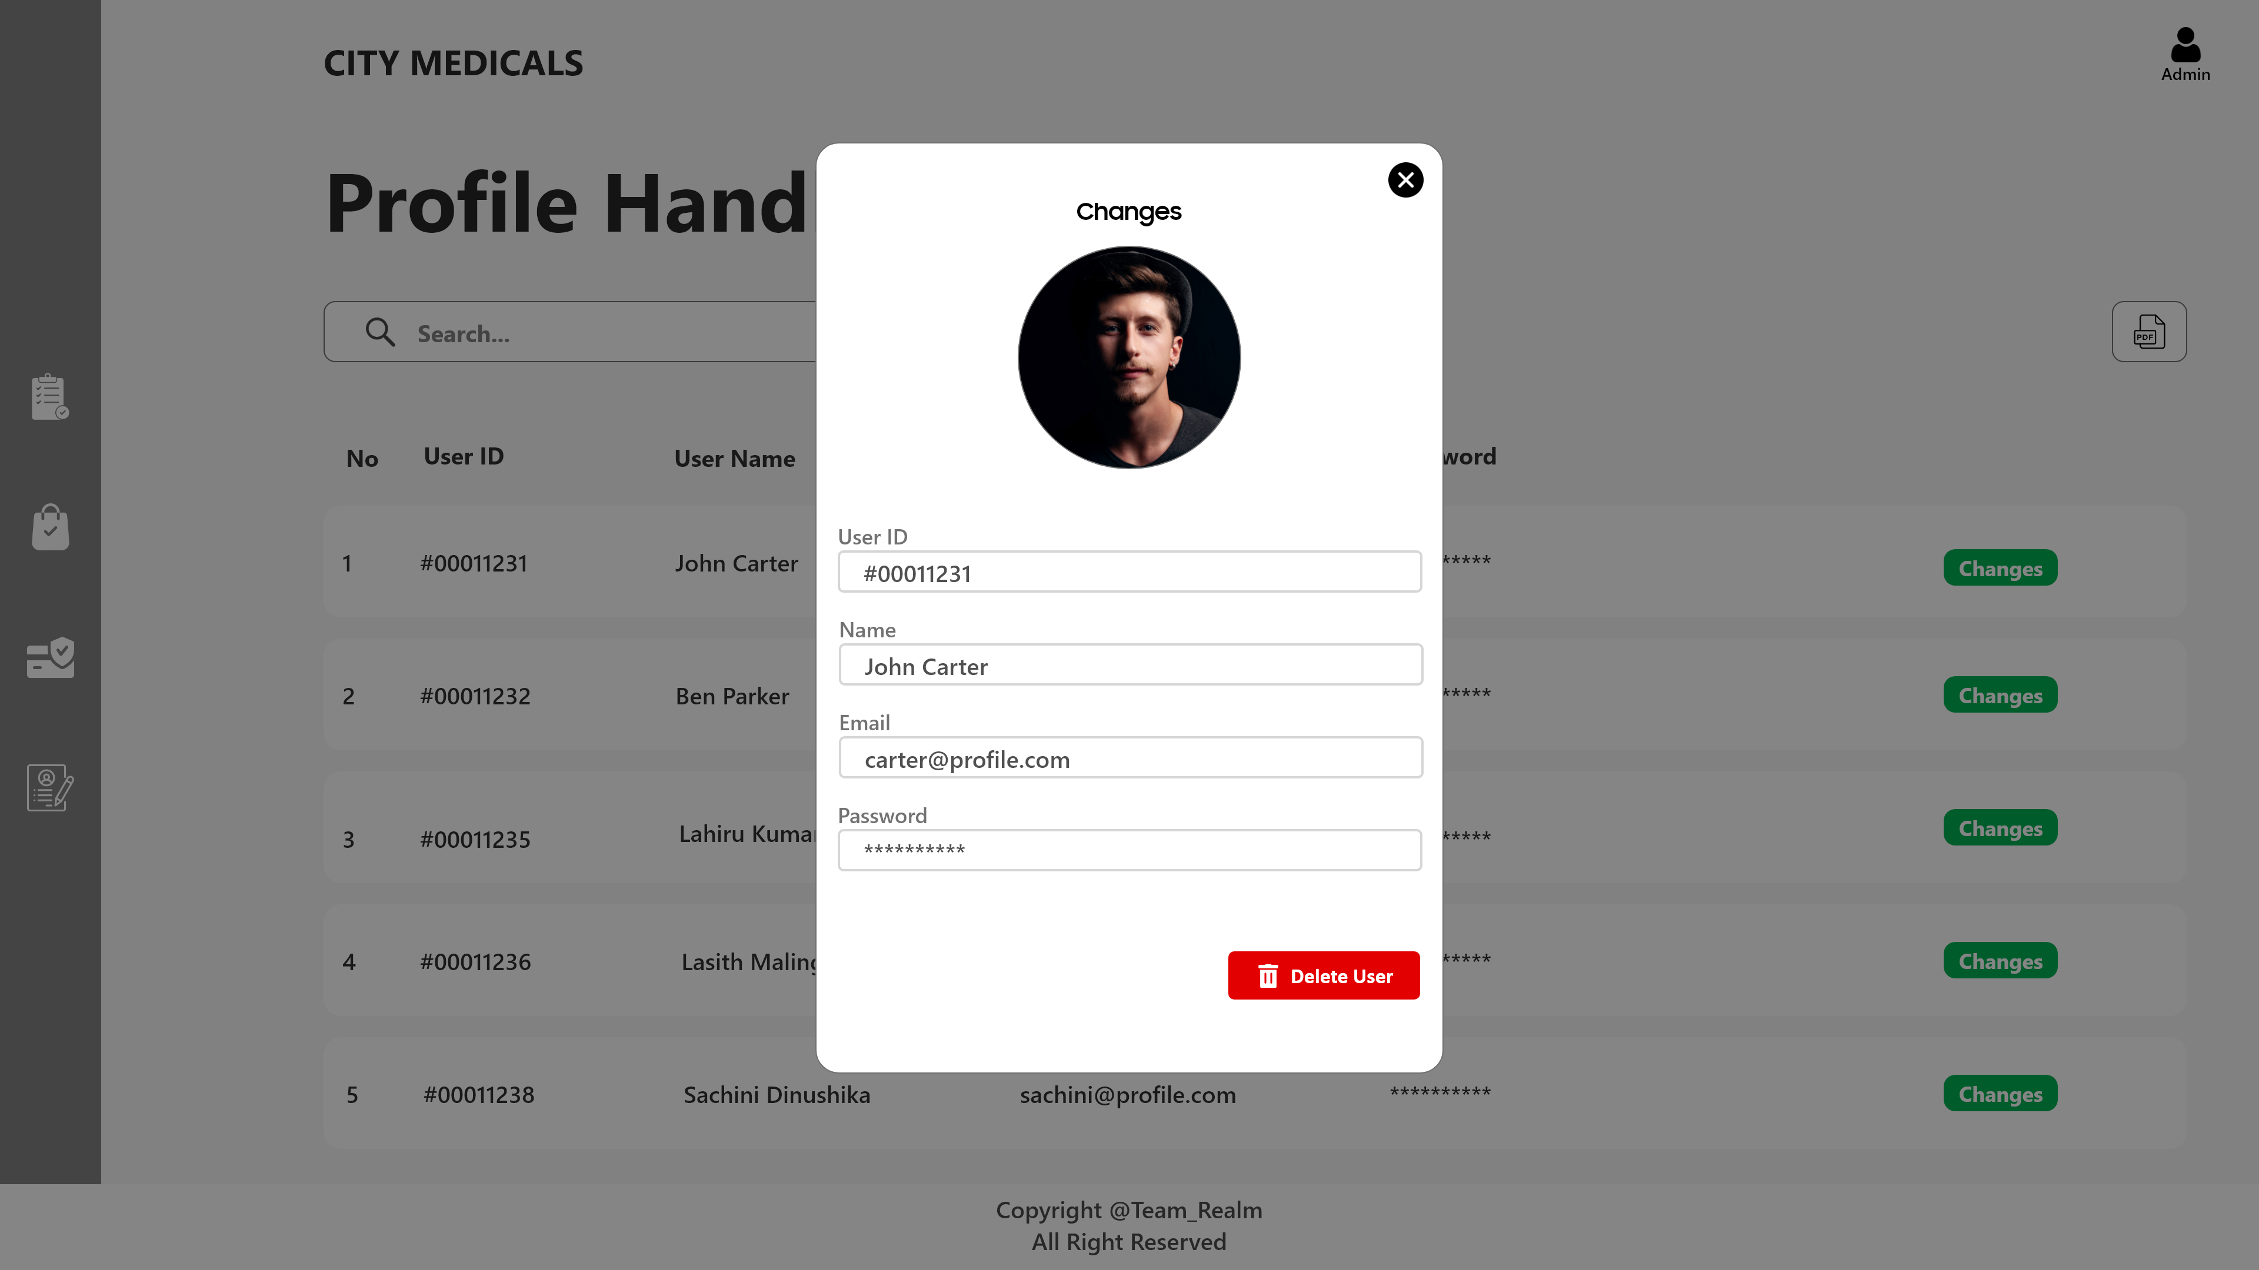
Admin-User Profile Edit

Slide 8
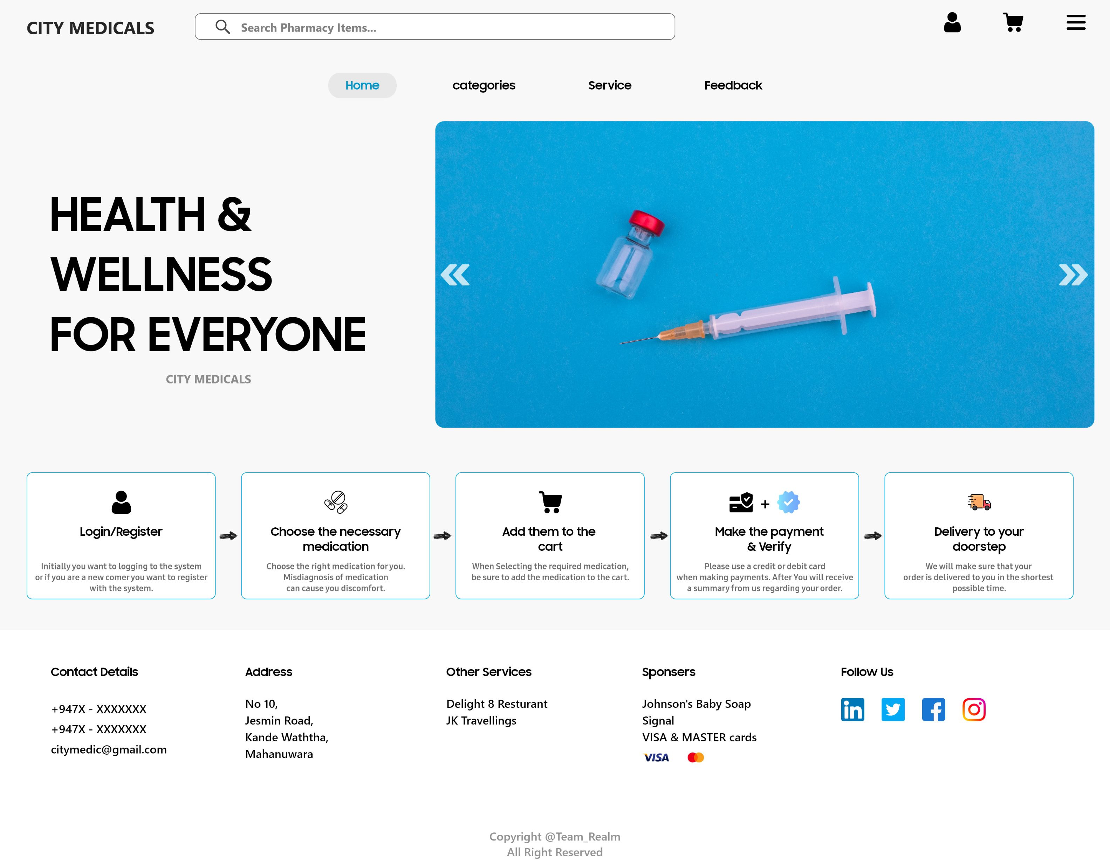
User Home

Slide 9
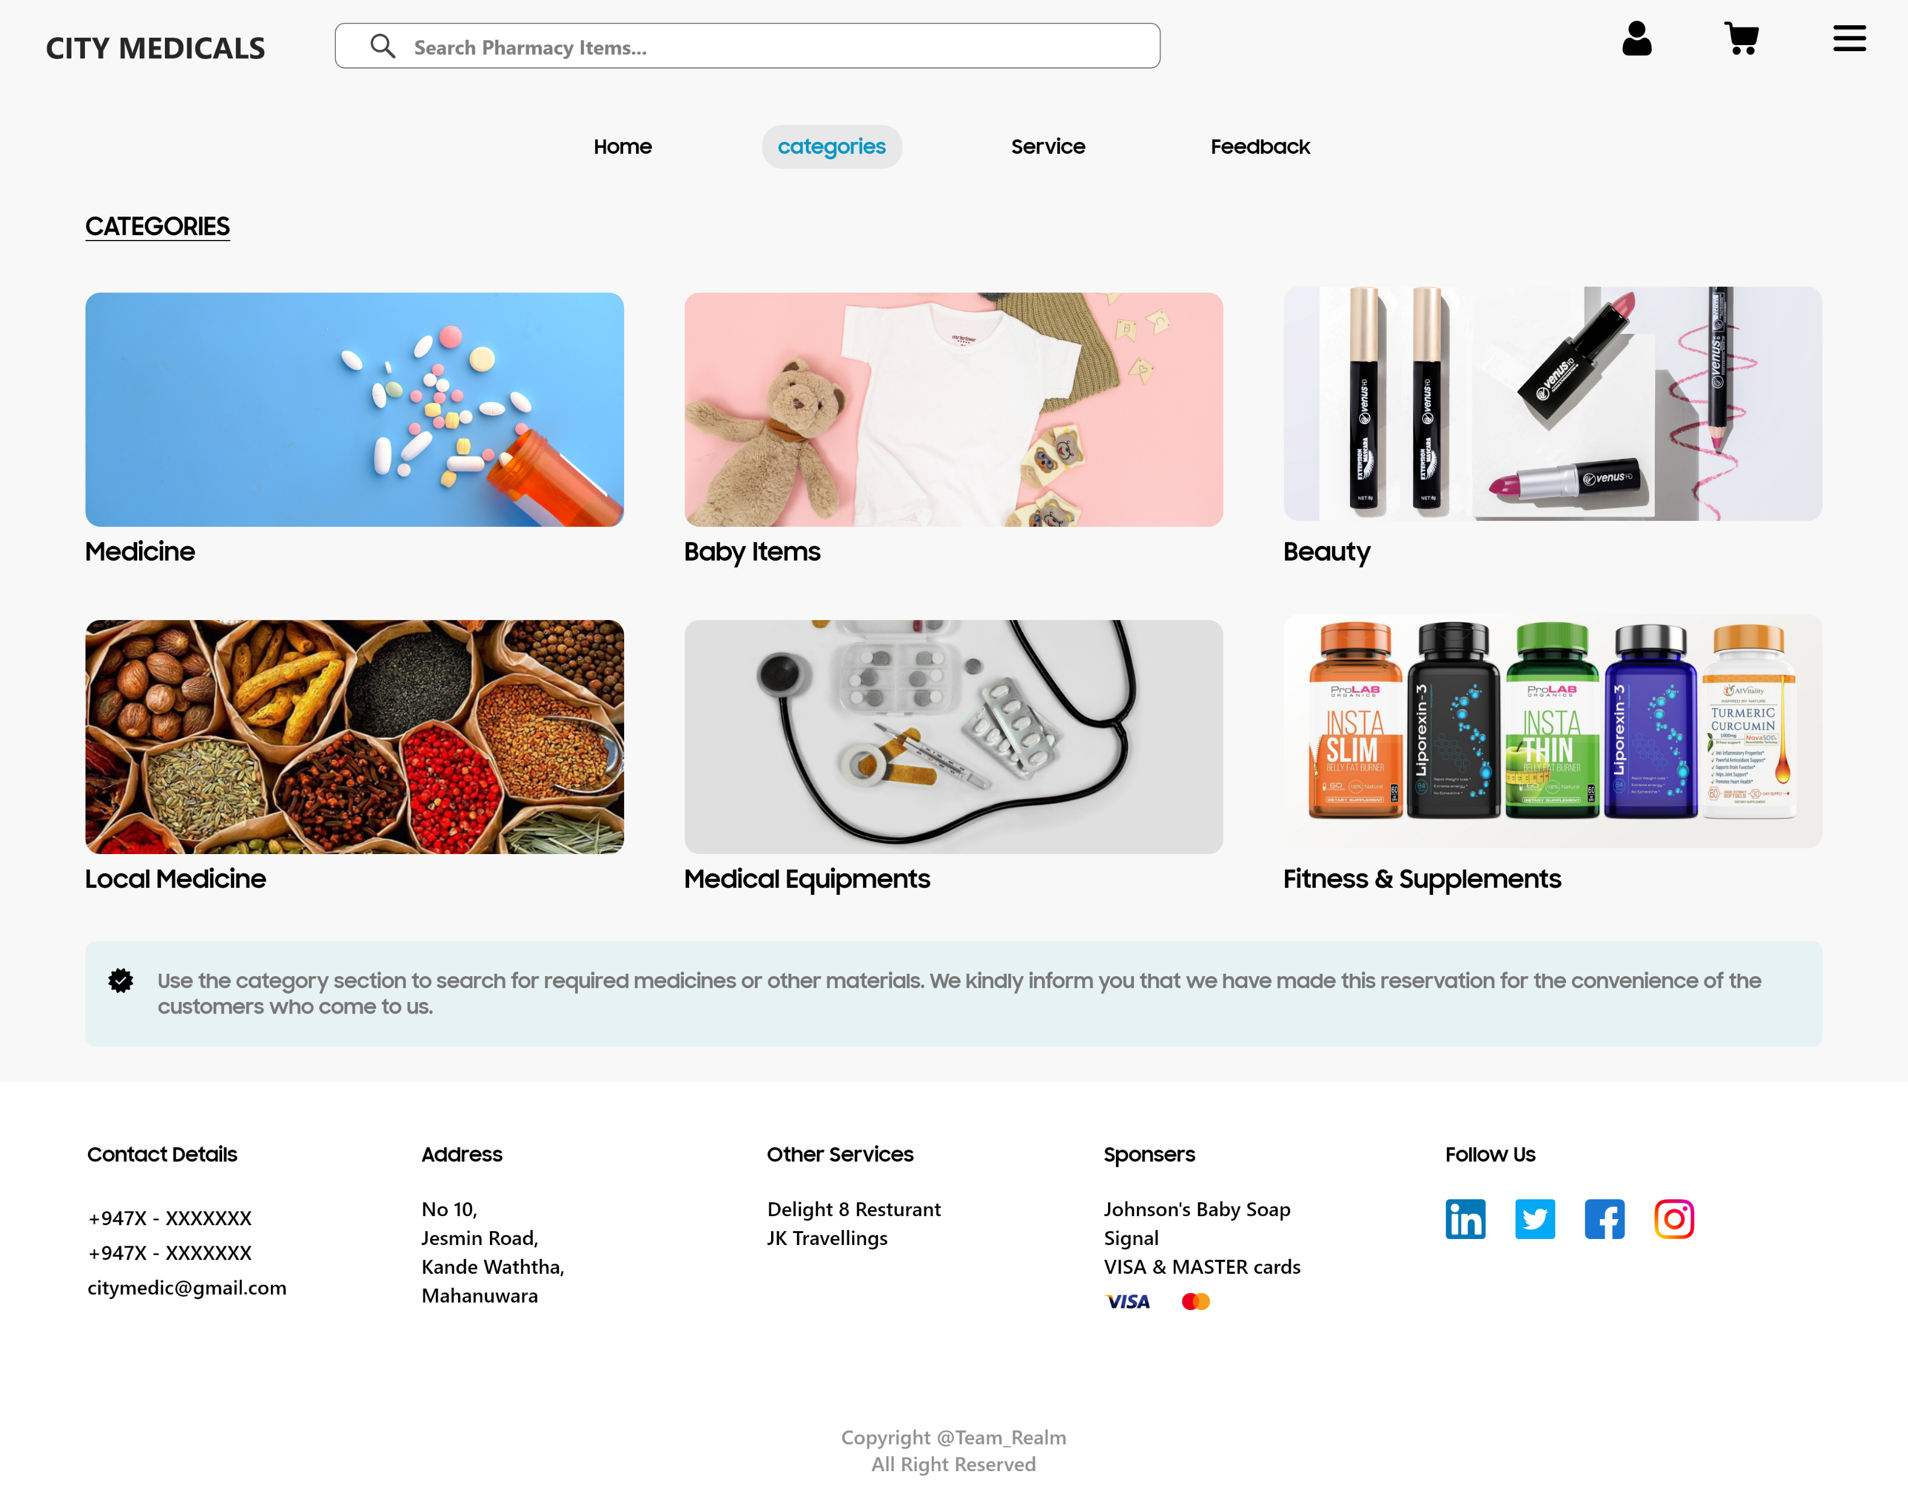
Category I

Slide 10
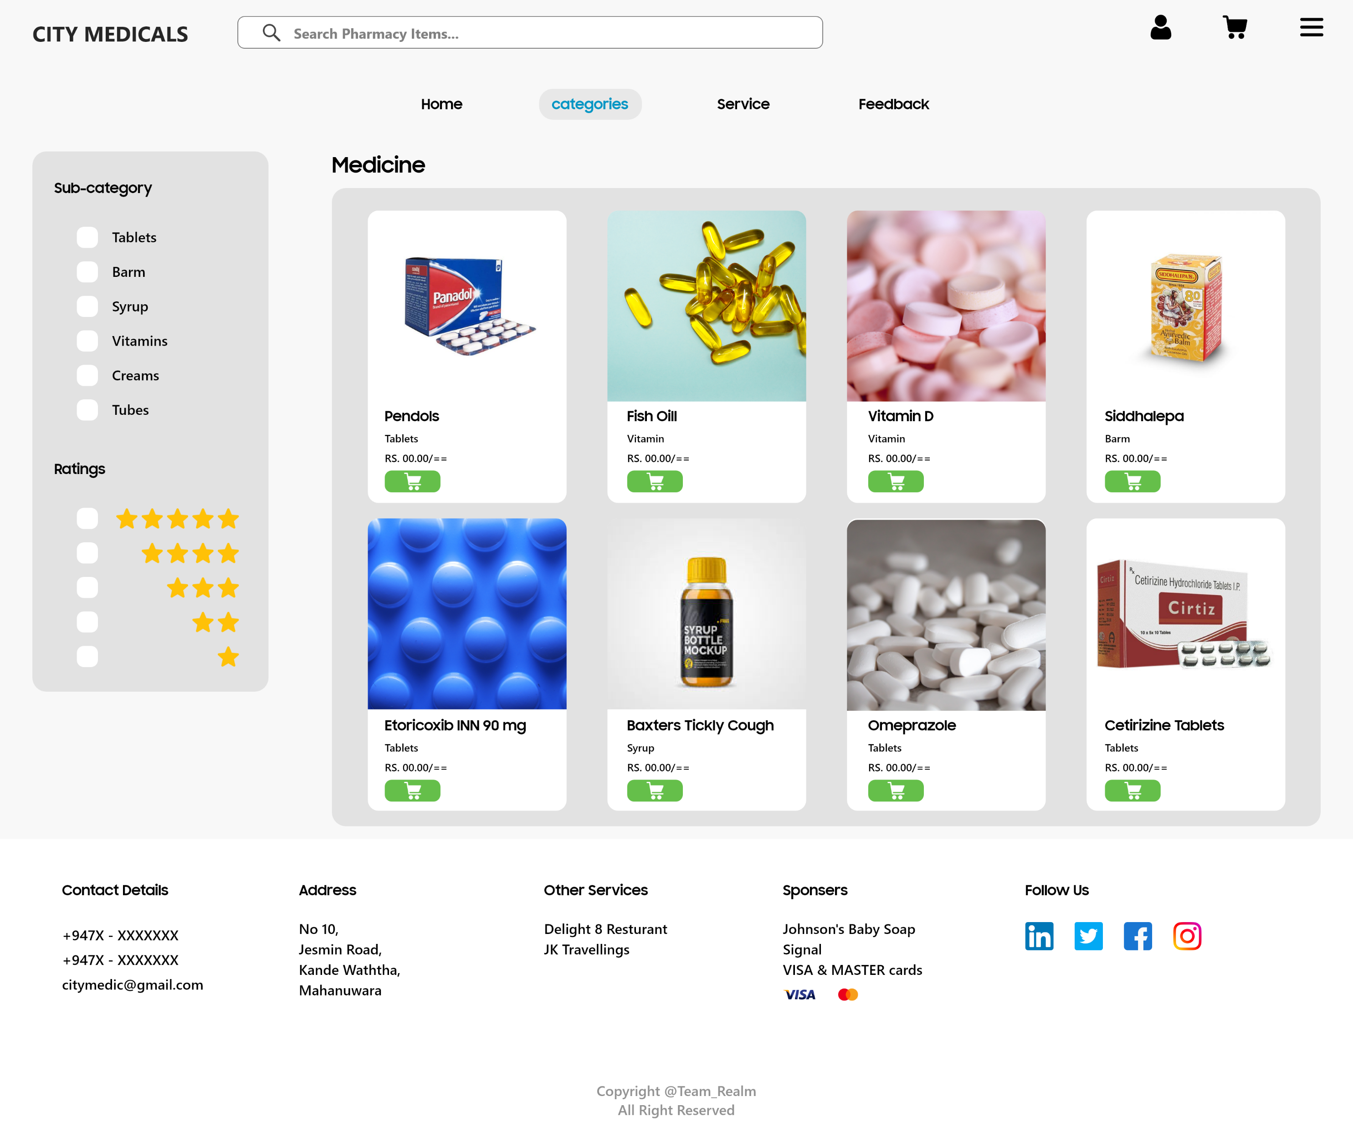
Categories II

Slide 11
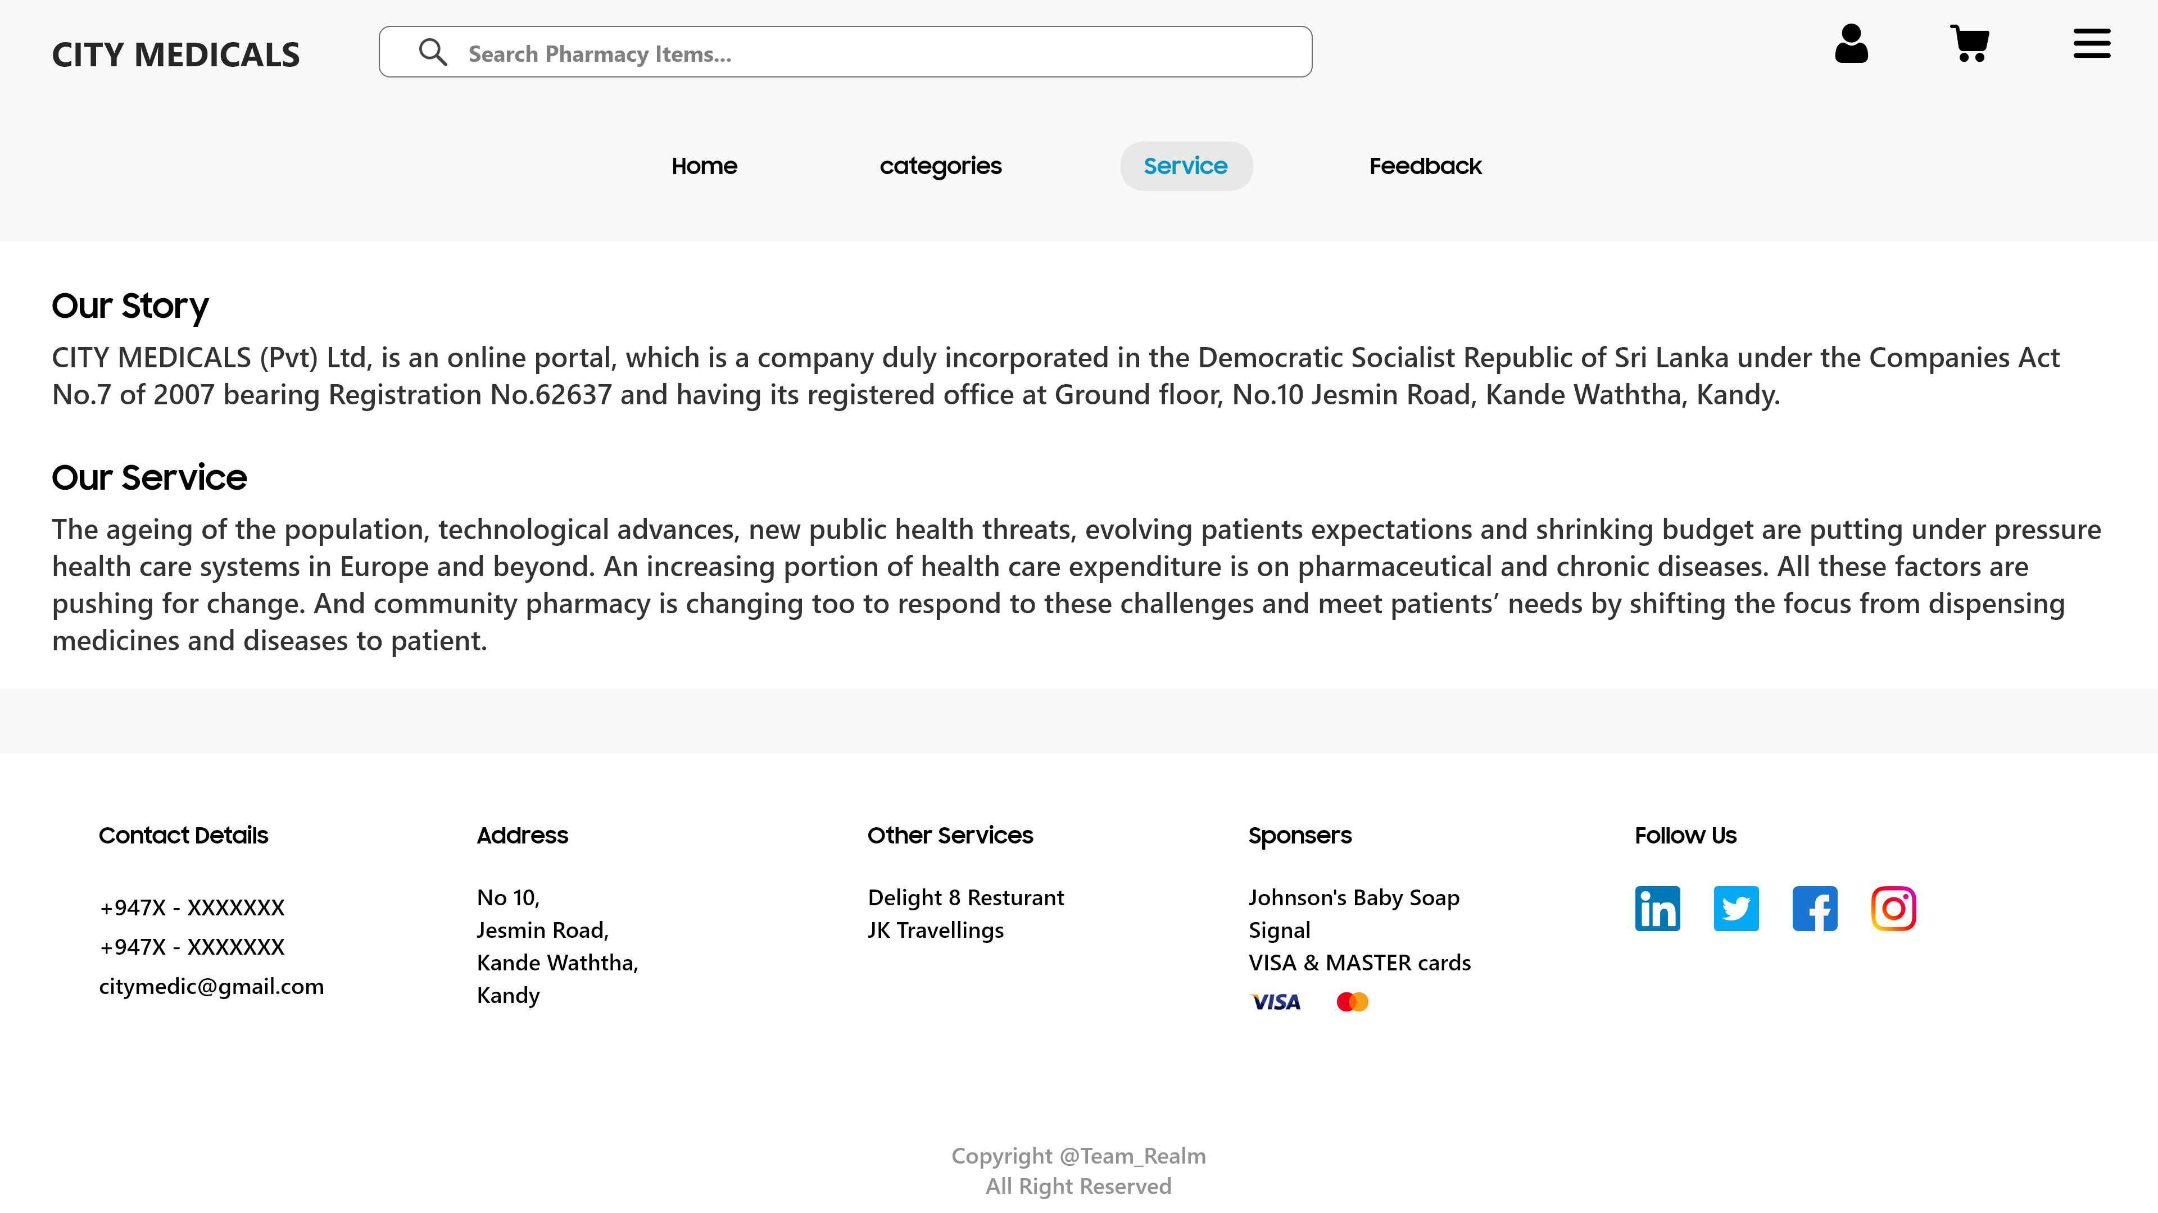
Service

Slide 12
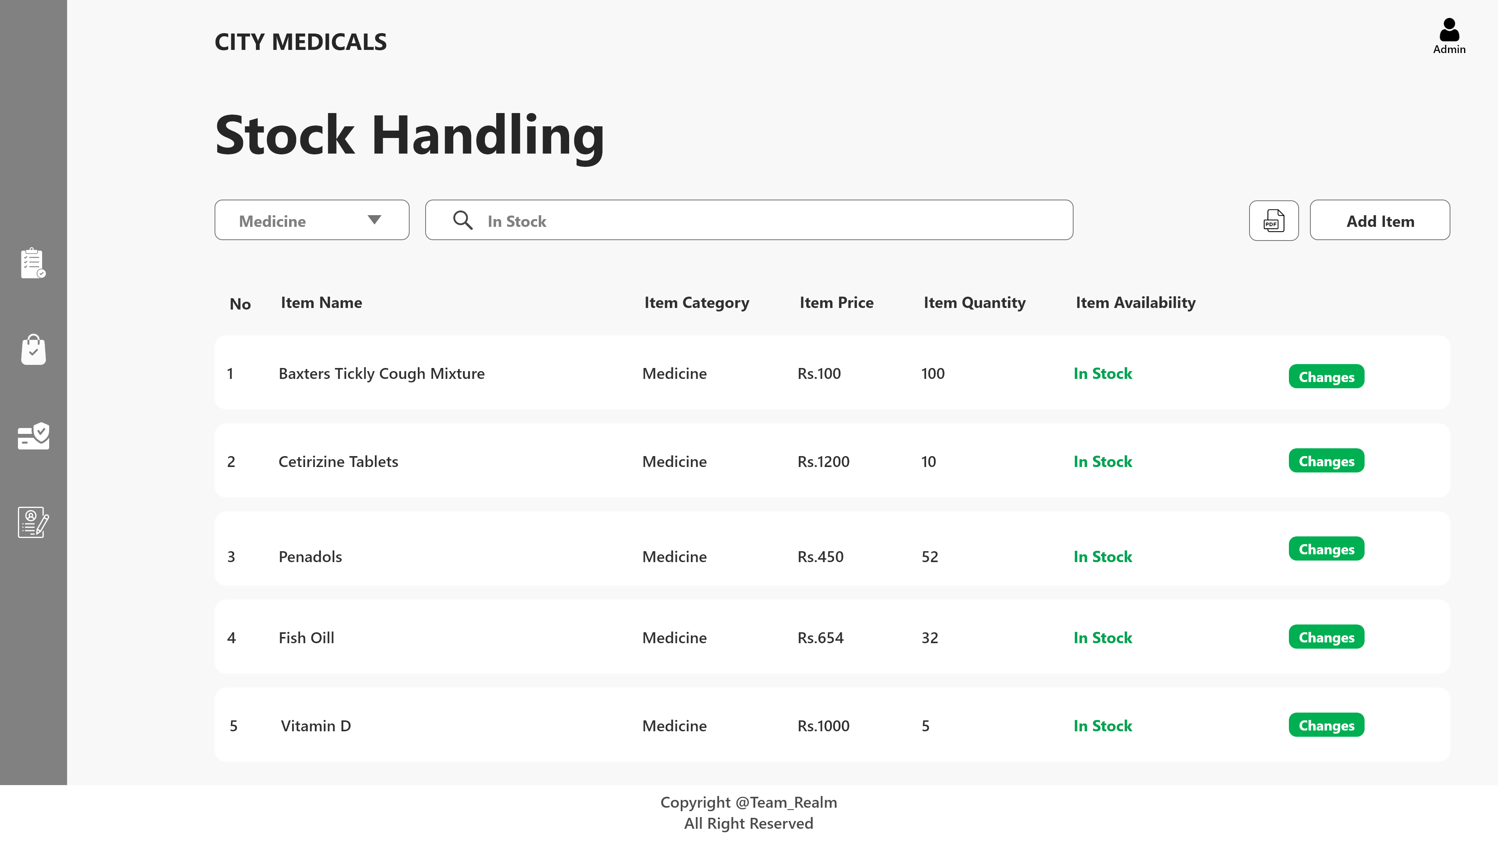
Admin-Stock Handling

Slide 13
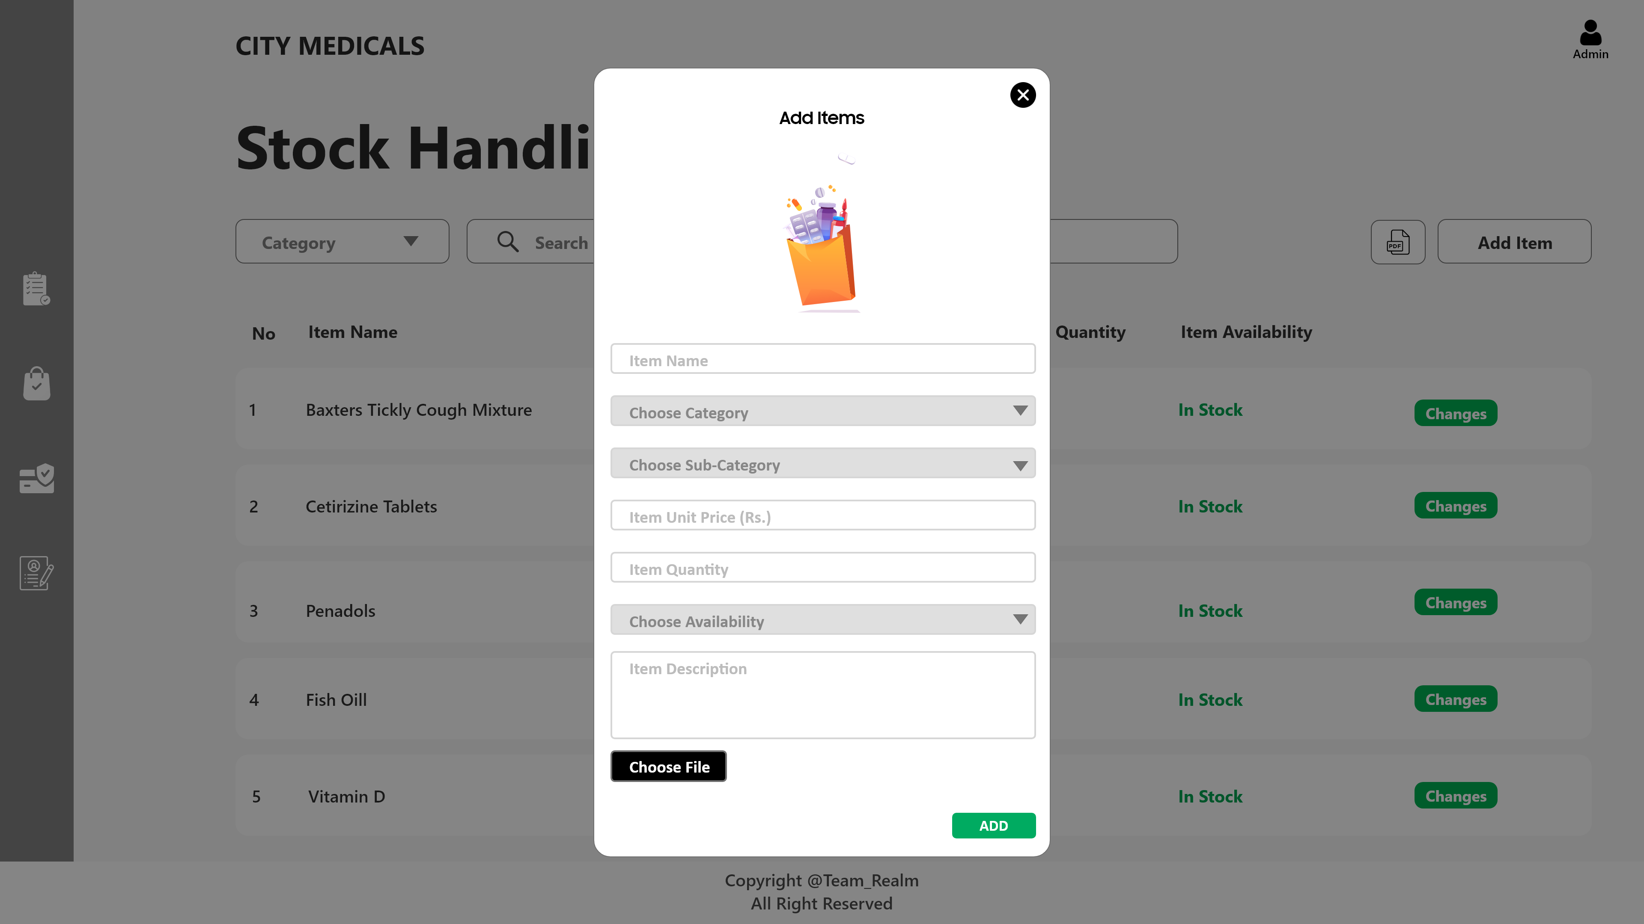
Admin-Add Items

Slide 14
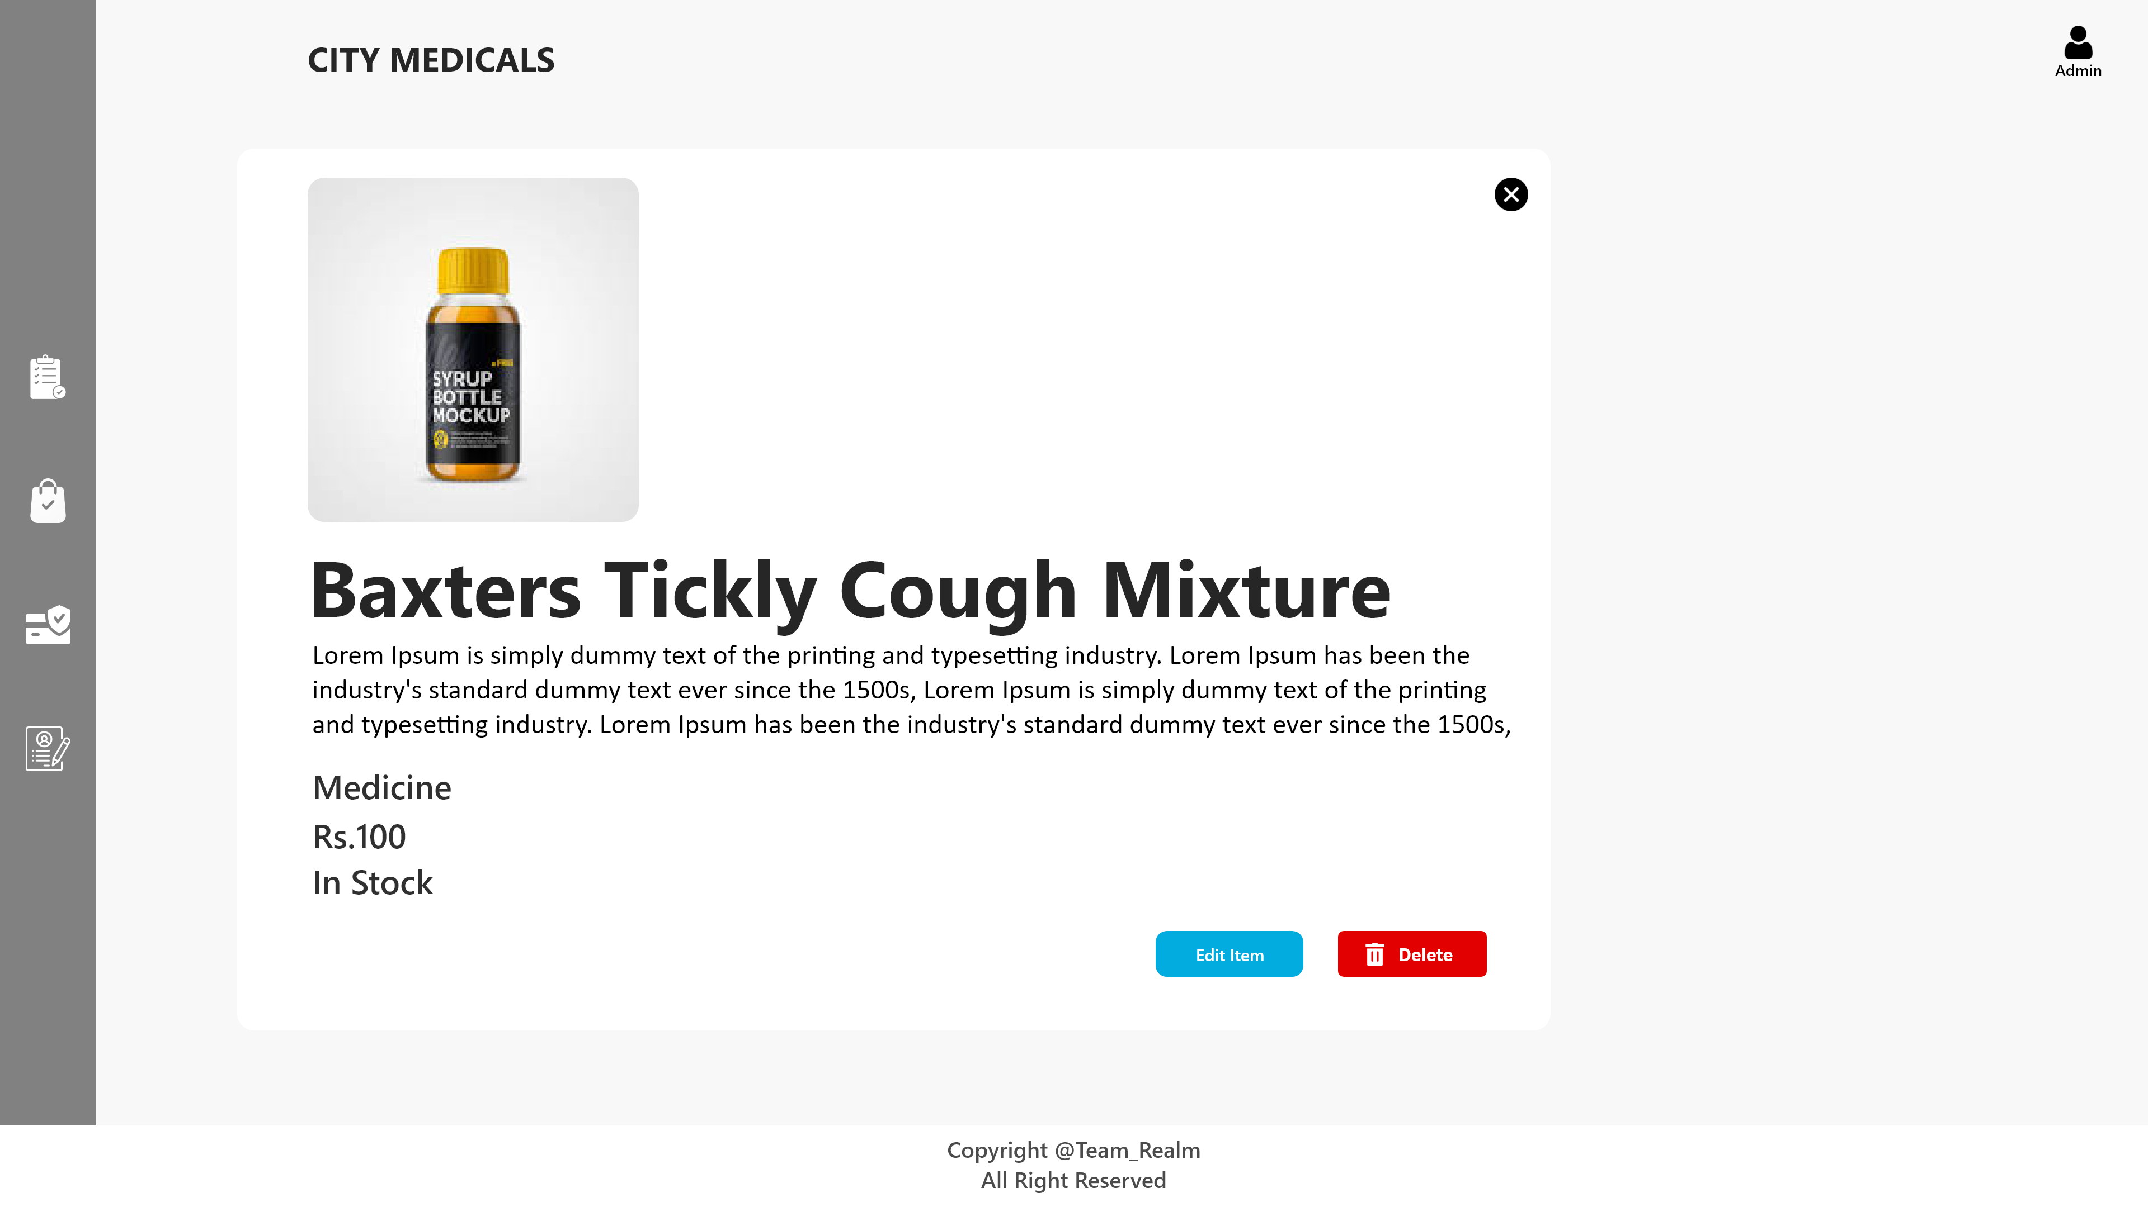
Admin-Edit Item

Slide 15
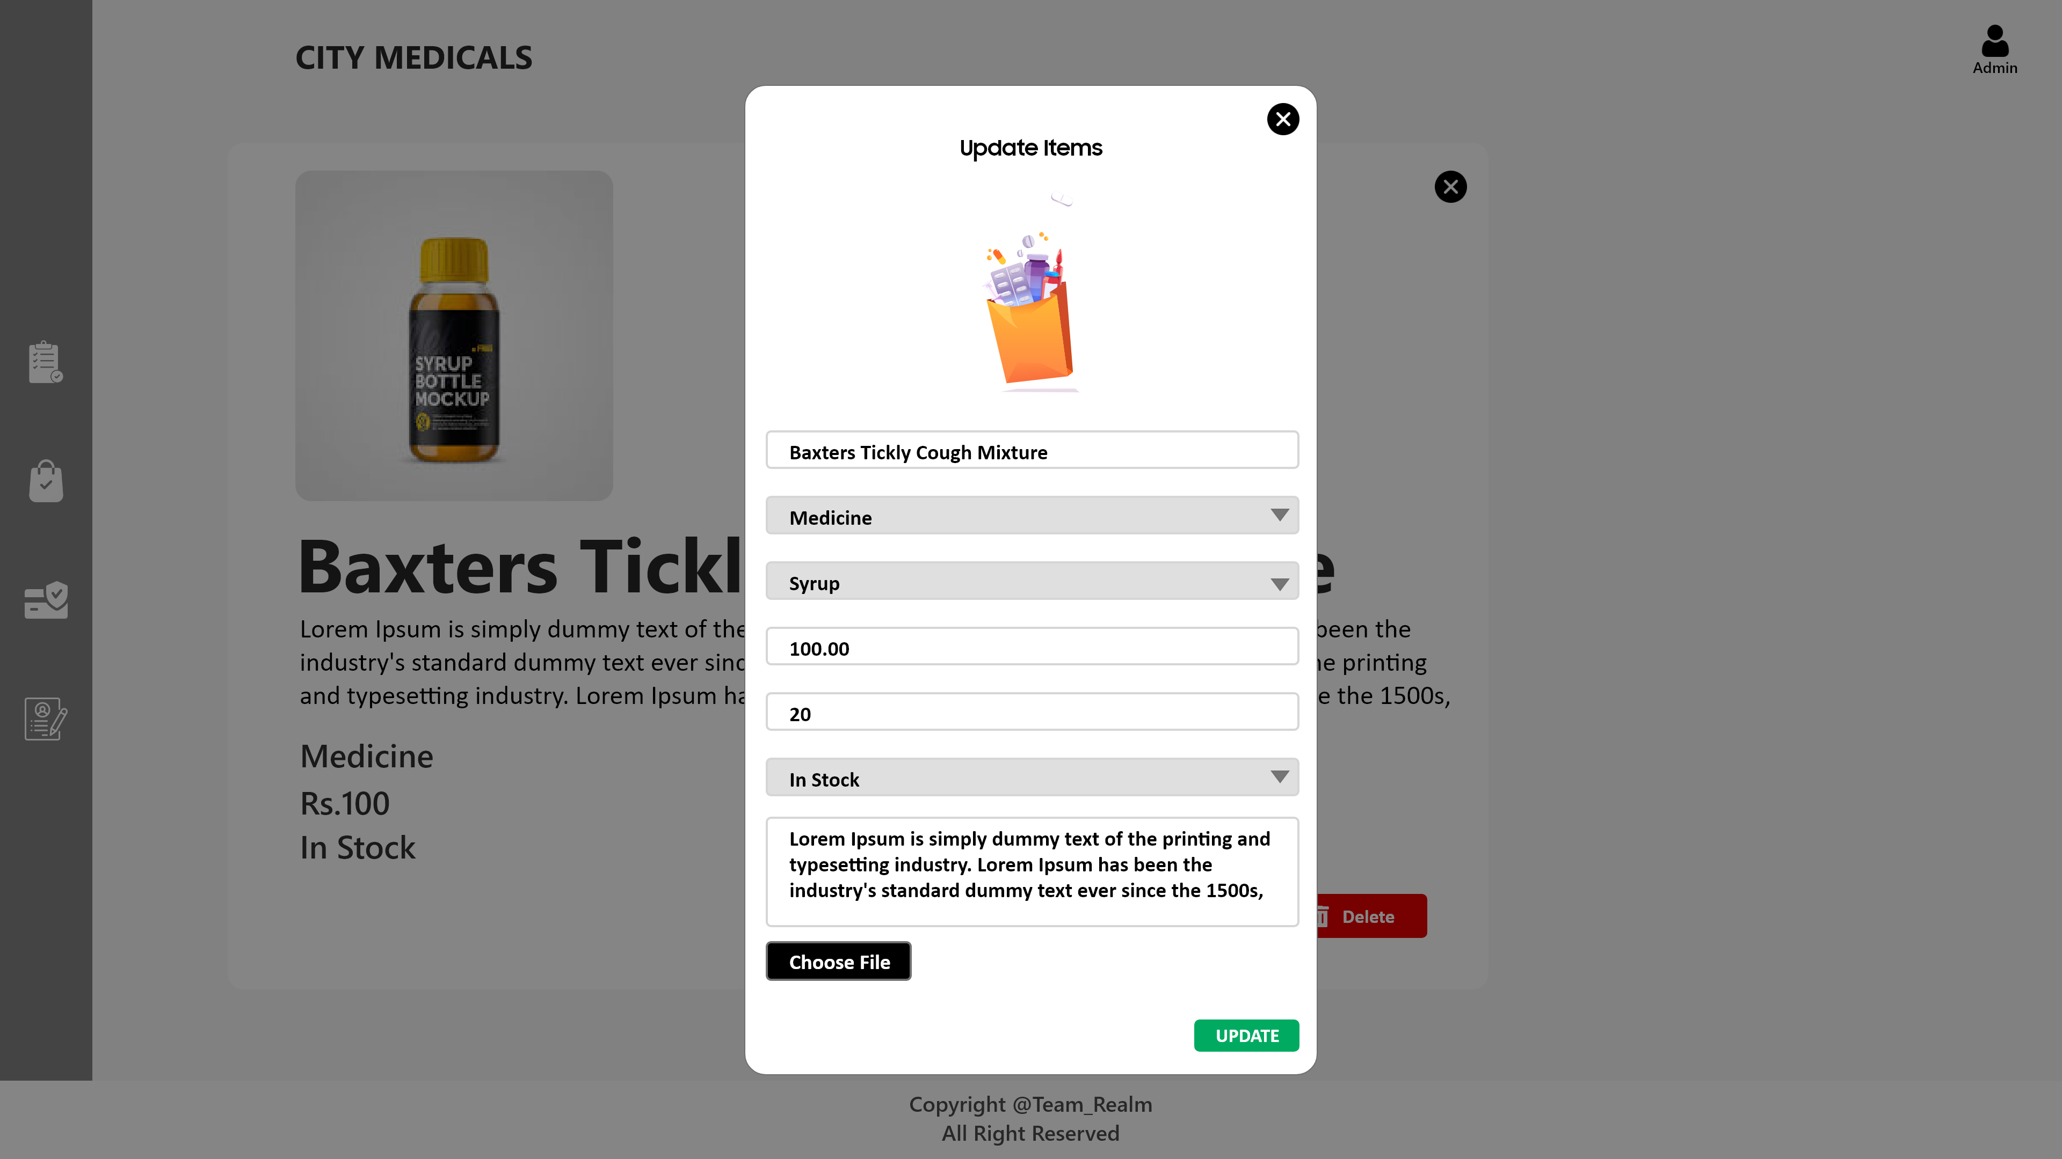
Admin-Update Item

Slide 16

User - Add to cart

Slide 17
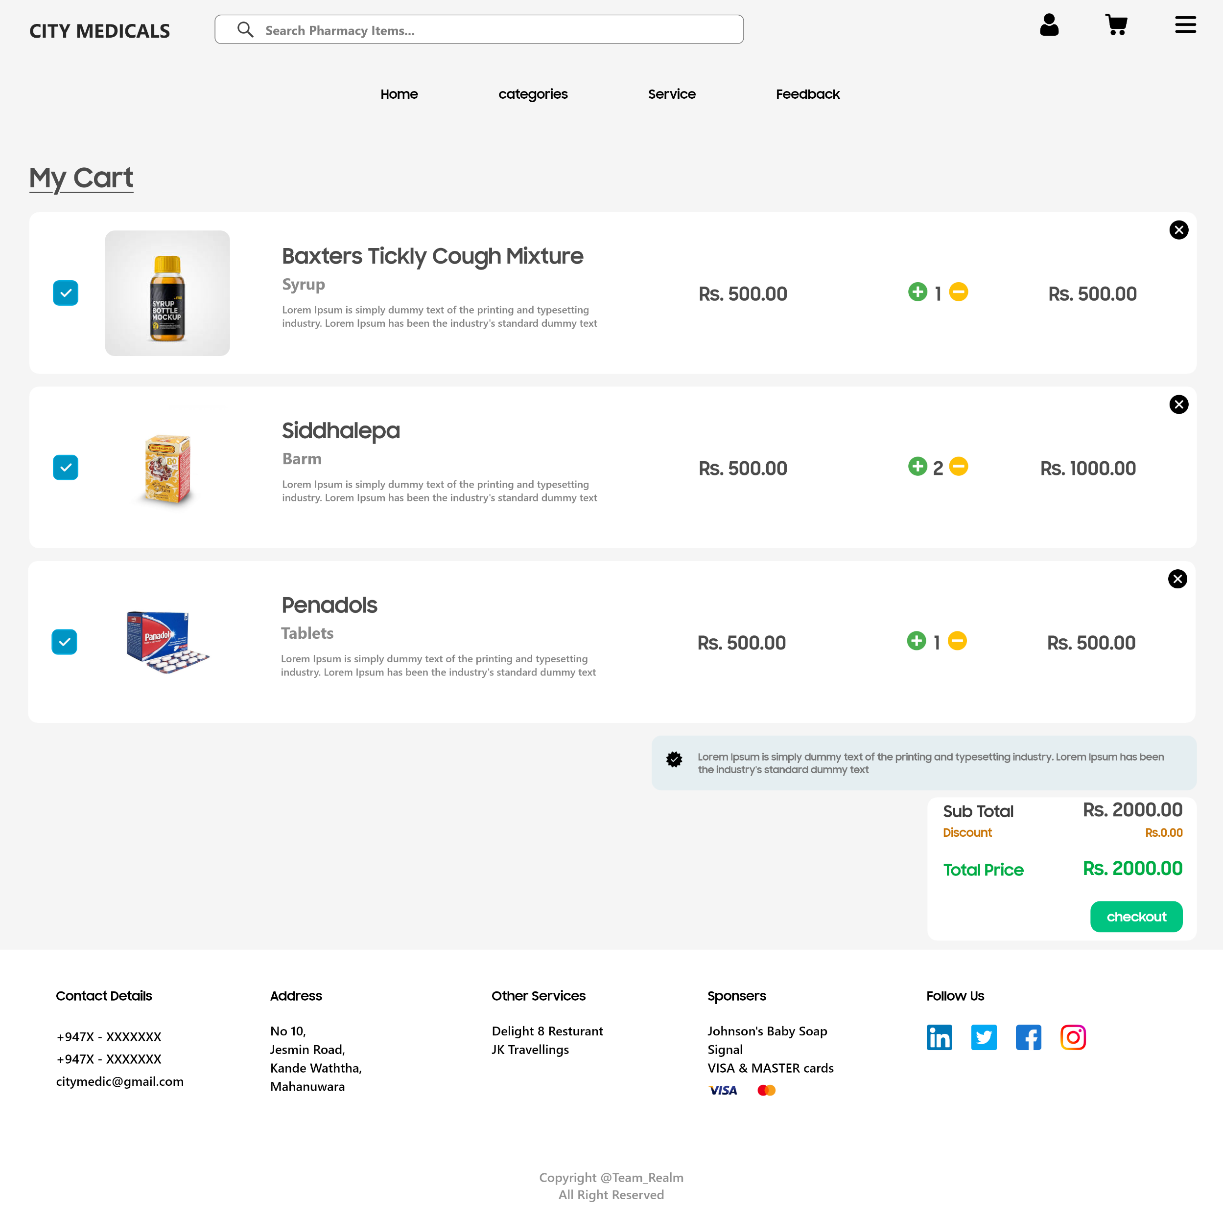
User - Cart

Slide 18
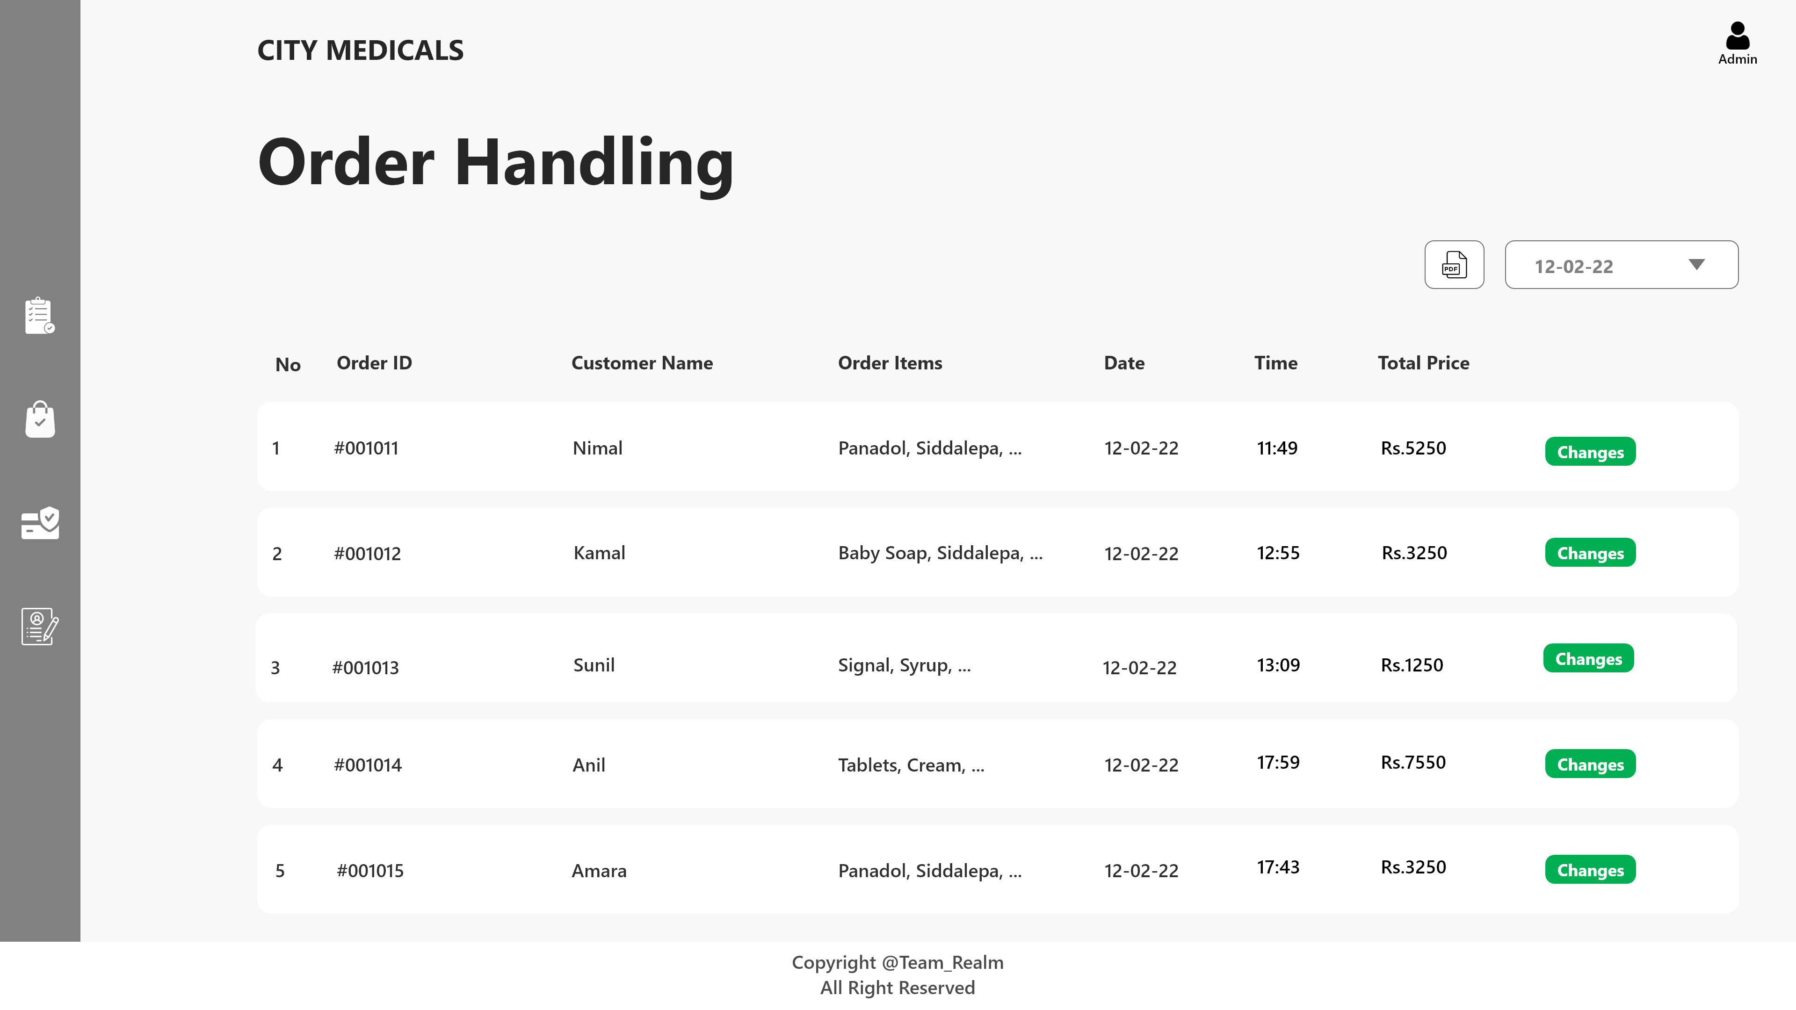
Admin – Order Handling

Slide 19
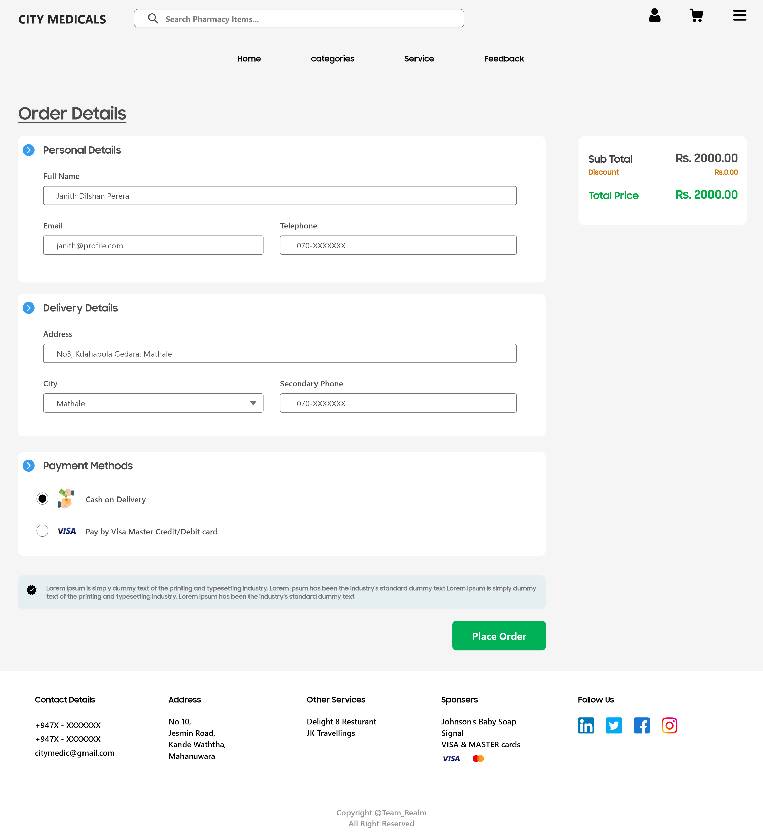
User-Get user Details

Slide 20
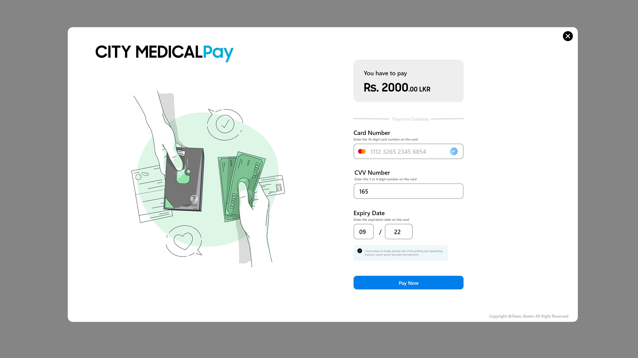
User-Payment Gateway

Slide 21
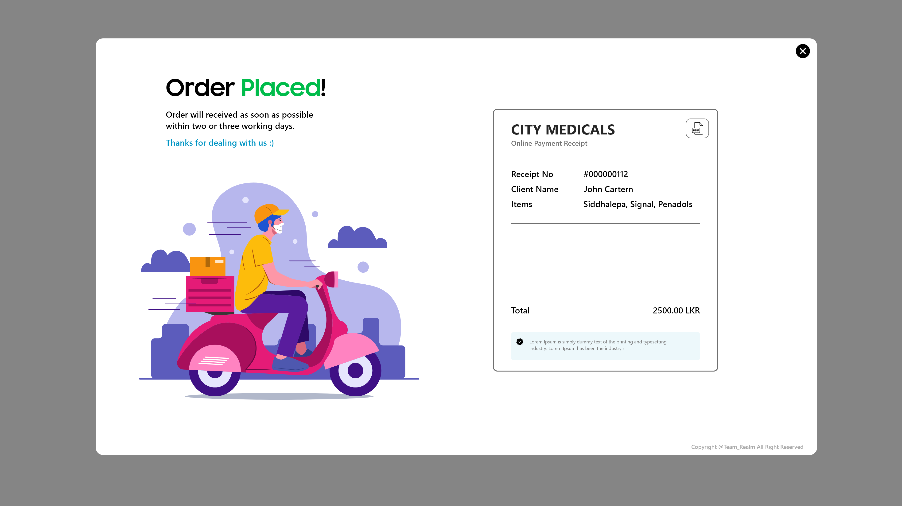
User – Order Report

Slide 22
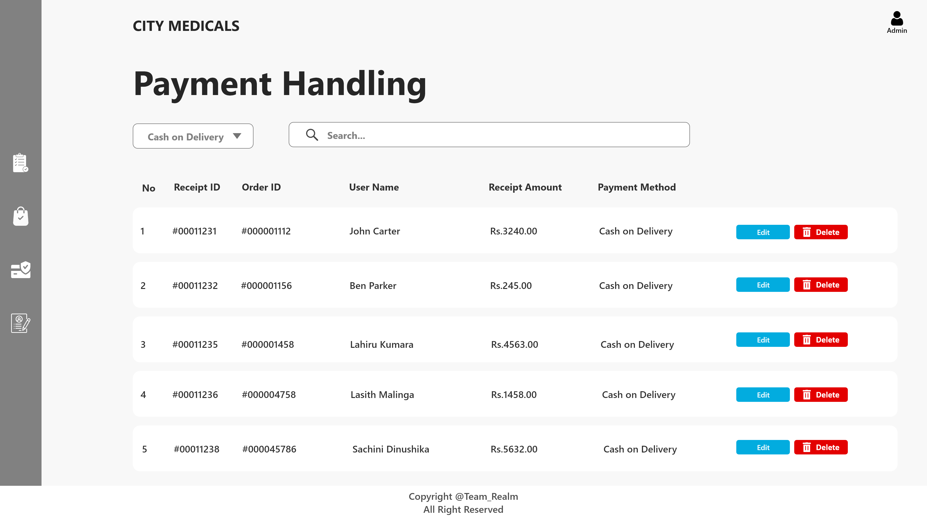
Admin Payment Handling

Slide 23
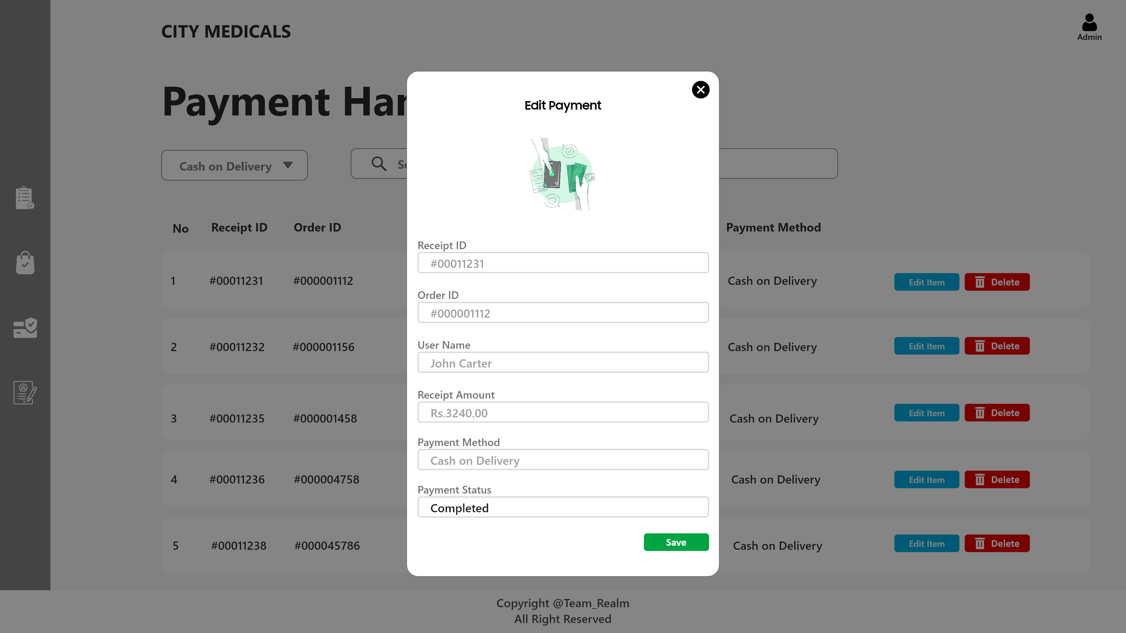
Admin-Order Status

